Slide 1

Feldman v. Google, Inc.
Group 9 - Emily Jao, haidah saad, simone orange, minh nguyen, sai anurag Sudagauni
Date – 4/7/2026

Slide 2
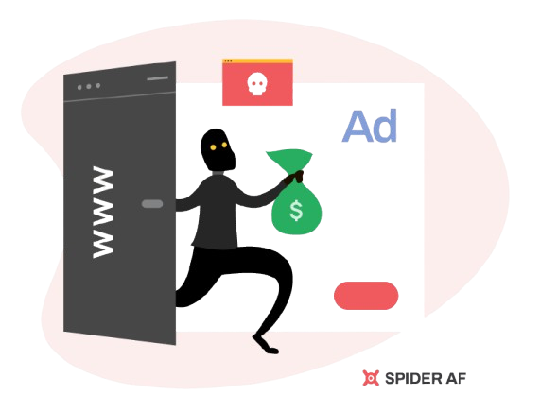
Summary
Case about online advertising + click fraud
Feldman claimed Google charged him via AdWords for fraudulent clicks and failed to prevent them
Google relied on its clickwrap agreement
Main issue: Is the forum selection clause in the online contract enforceable?
Court Ruling: In favor of Google

Slide 3
Timeline
Jan 2003
Feldman starts using Google AdWords
~2005
Dec 2005
Click fraud occurs
(20–30% of clicks)
Accumulates $100,000+ in AdWords charges
~2006
Feldman files lawsuit
(E.D. Pennsylvania)
& Amended Complaint
2007
Court reviews cross-motions for summary judgment.
Mar 28, 2007
Court rules for Google. Feldman's motion denied.

Slide 4
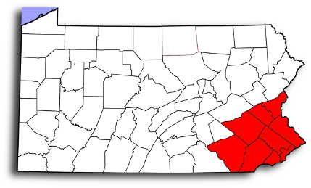
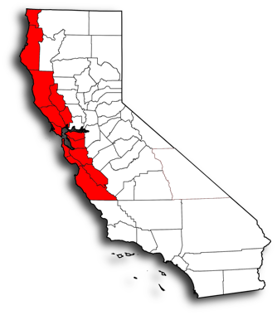
Procedural History
Feldman sued Google in federal court (E.D. PA)
    Claims: Click fraud + unfair charges
Google filed
    Motion to Dismiss → Summary Judgment
    Motion to Transfer venue to Santa Clary County, CA
Feldman filed
    Cross-Motion for Summary Judgment
Court decision:
    Clickwrap agreement valid
    Forum selection clause enforceable
    Contract not unconscionable
    → ruled in favor of Google

Slide 5

Facts
Feldman argued:
Google argued:
Google failed to stop click fraud
Had tools to detect fraud but didn’t use them
Didn’t:
  Warn users about click fraud
  Investigate complaints
Only kept records for the last 3 months and disclaimed liability for clicks older than 60 days
Charged $100k+
Feldman agreed to the clickwrap contract
He is an attorney with full notice of the terms
The contract was not unconscionable because no high-pressure tactics were used and competing ad services existed
Disputes must be handled in California

Slide 6

Legal Questions
Did Feldman have a binding contract with Google through AdWords clickwrap agreement, and is the agreement enforceable?
Is the forum selection clause in the AdWords agreement enforceable, or can it be challenged as unconscionable?

Slide 7
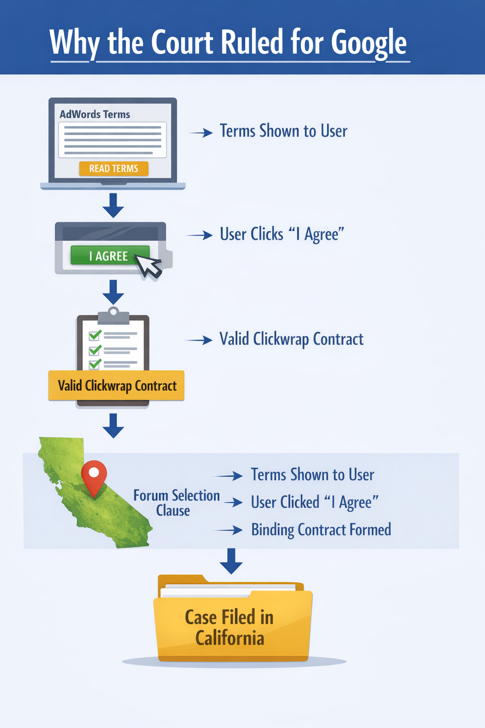
Legal Answers
Yes
  Clickwrap agreement is legally enforceable
  User had reasonable notice of terms
  Clicking “I agree” shows assent
Yes
  Forum selection clause is valid
  Contract not procedurally unconscionable
  Case must follow agreed forum

Slide 8
Discussion
California law was used in this diversity case.
Plaintiff said the agreement wasn't an express contract. This was disproved based upon the difference between an express and implied contract.
  Whether or not terms are stated
Cited Specht v. Netscape Comms. Corp.
  One download button did not visibly have indication of T&Cs and required going through multiple links
  Another where users had to agree to terms or else they couldn't download software
AdWords was similar to the second agreement, and so it was ruled an express contract with mutual assent.

Slide 9
Discussion
Plaintiff argued the agreement was unconscionable
  Can only be unconscionable if it has hidden terms and if there are one-sided results
In California law, it's only unconscionable if it's an adhesion contract(contracts made by a superior party with no negotiations)
Defendant argues about Plaintiff understanding any tactics and knowing of other advertising options.
  Plaintiff argued back that the next best option had a similar agreement method
Not enough evidence for it to be unconscionable, motion for summary judgment denied.

Slide 10
Analysis
Clickwrap agreements are binding – Clicking "I agree" forms a valid contract; users are responsible for terms they had a fair chance to read
Clear notice matters – Requiring users to click "I agree" before proceeding satisfies the notice requirement (unlike Specht v. Netscape, where terms were buried)
Ignorance is not an excuse – Failing to read accessible terms is not a valid defense against enforcement
Unconscionability claim failed – A take-it-or-leave-it format alone isn't enough; terms must also be substantively one-sided to be unenforceable

